Slide 1

EMPLOYEE ATTRITION ANALYSIS
BY :-
ASMITA GUPTA
KARAN ASAWA
AYUSH KUMAR
UMANG SHARMA

Slide 2
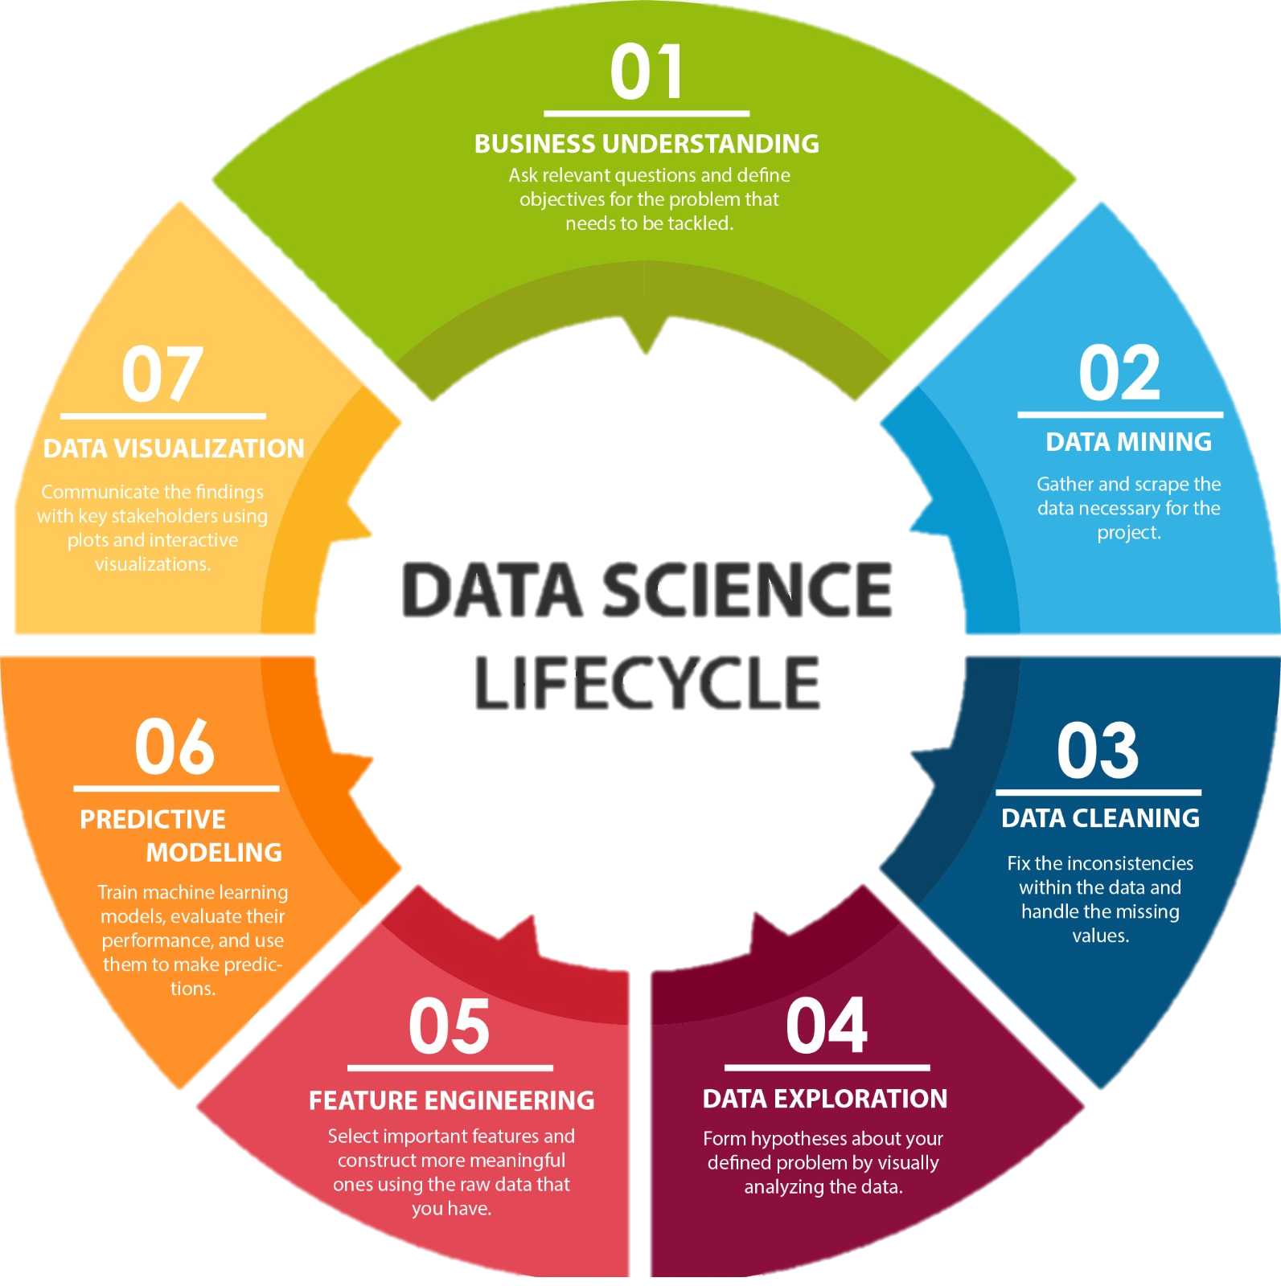
DATA SCIENCE LIFECYCLE

Slide 3
PROBLEM STATEMENT :-
Based on department data and employee data regarding administrative, work-load and mutual evaluation score predict whether an employee will stay or leave .The target variable in our project is "ATTRITION“.
What do you mean by Attrition?
Attrition refers to the gradual but deliberate reduction in staff that occurs as employees leave a company and aren't replaced. Employees may leave voluntarily or involuntarily.

Slide 4
Employee attrition is the practice of leaving roles unfilled following workers’ departures. Employers will often eliminate positions, restructure departments, or implement a hiring freeze instead of bringing on new staff. There are many reasons for employee attrition, including cost-saving and organizational change.
This concept is similar to employee turnover, quiet quitting and signs employees will quit. By understanding attrition, leaders can design smarter retention strategies and revamp the interview process.

Slide 5
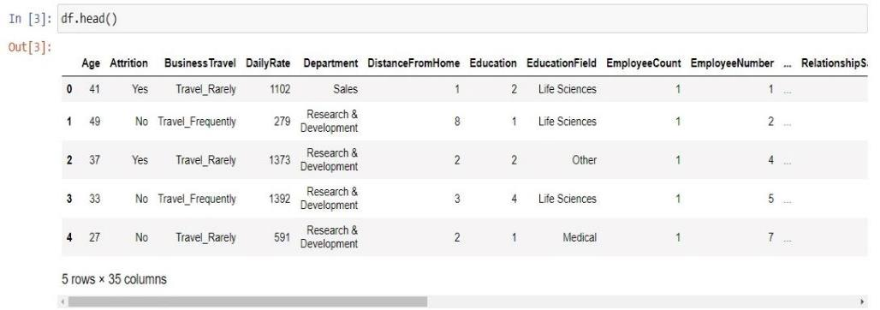
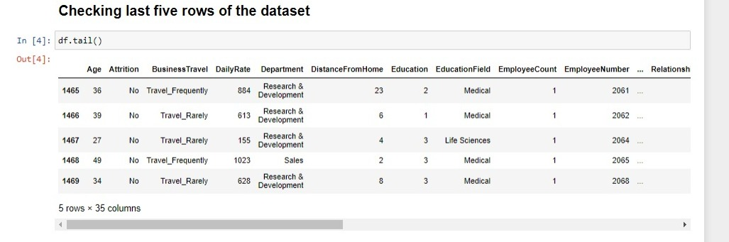
EXPLORATORY DATA ANALYSIS
TOP FIVE ROWS OF THE DATASET
Exploratory data analysis refers to the critical process of performing initial investigations on data so as to discover patterns , to spot anomalies , to test hypothesis and to check assumptions with the help of summary statistics and graphical representations.
LAST FIVE ROWS OF THE DATASET

Slide 6
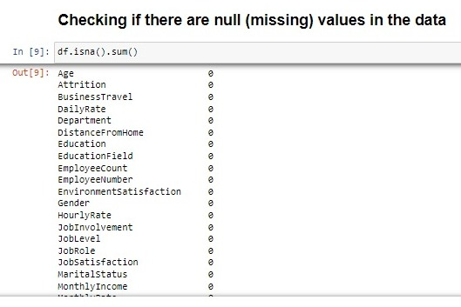
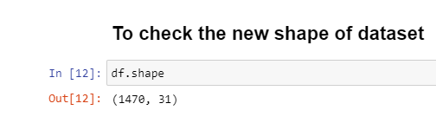
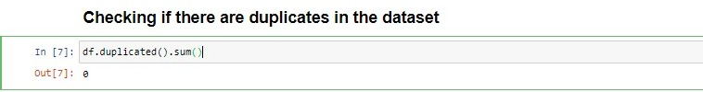
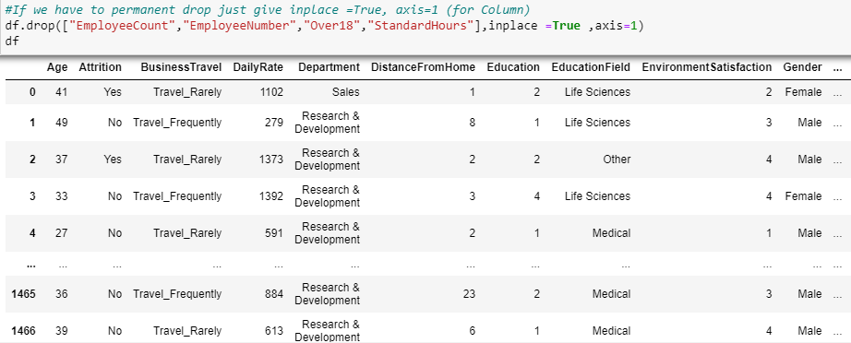
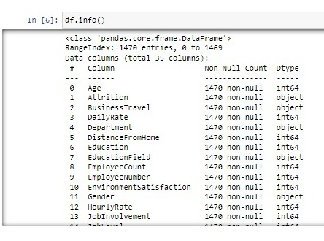
NULL VALUES
SHAPE OF DATASET
DUPLICATE VALUES
DESCRIPTION OF DATA
INFO OF DATA

Slide 7
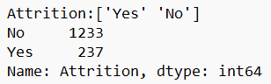
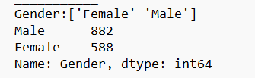
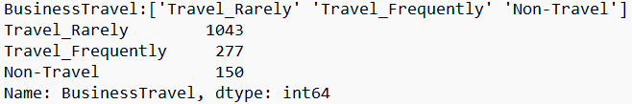
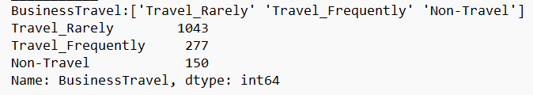
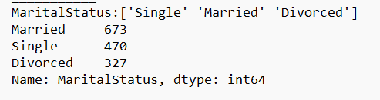
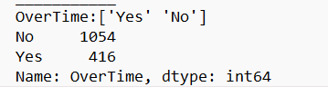
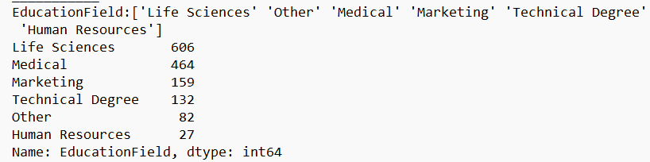
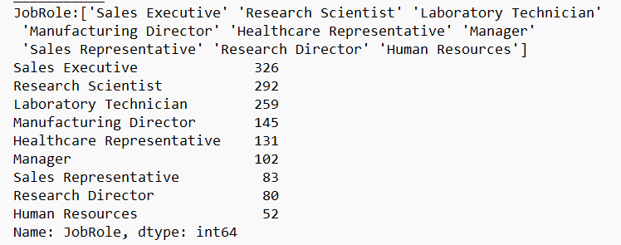
UNIQUE VALUES

Slide 8


Slide 9
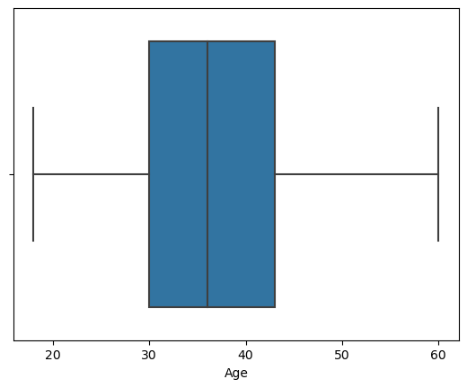
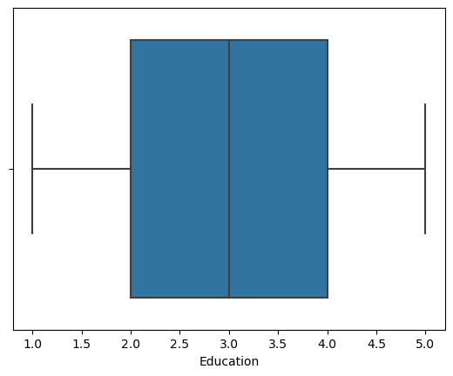
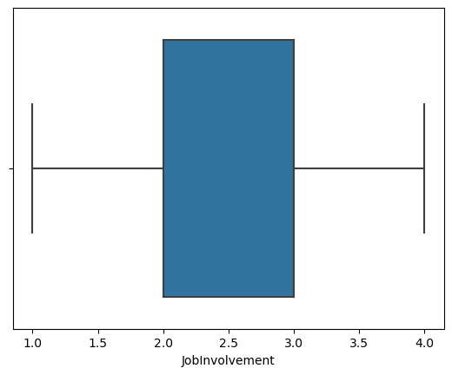
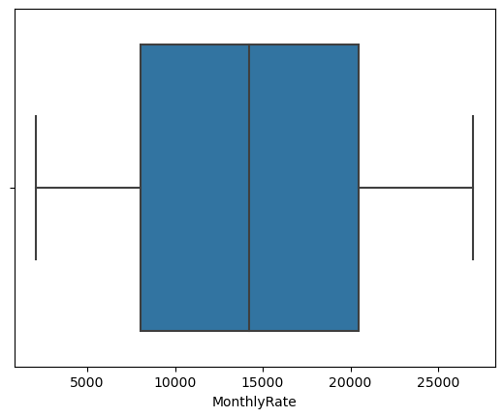
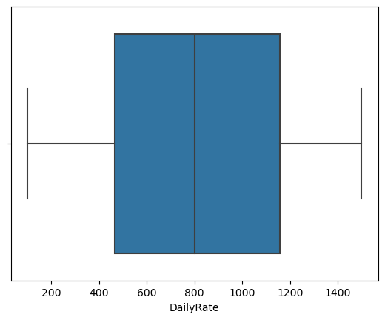
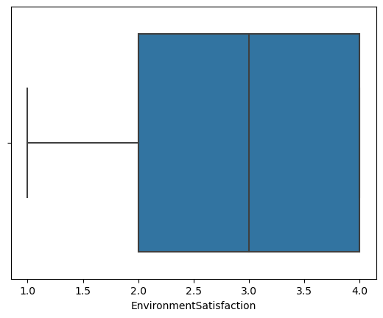
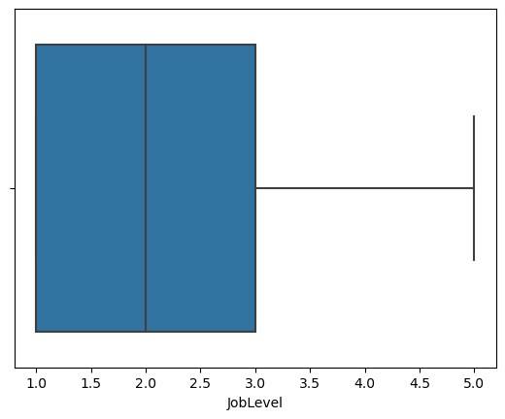
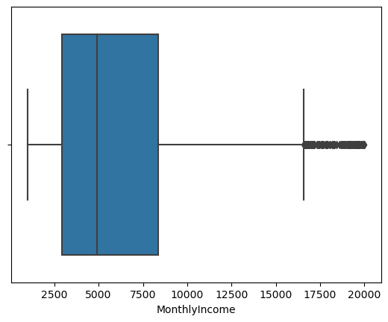
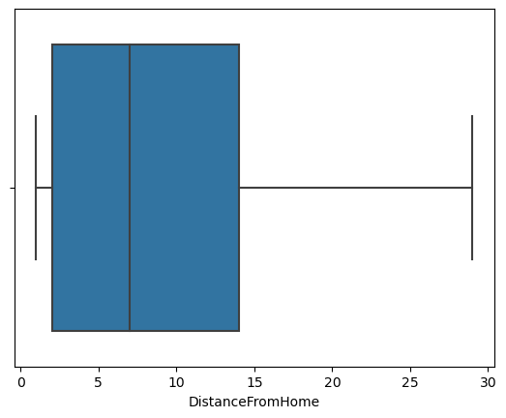

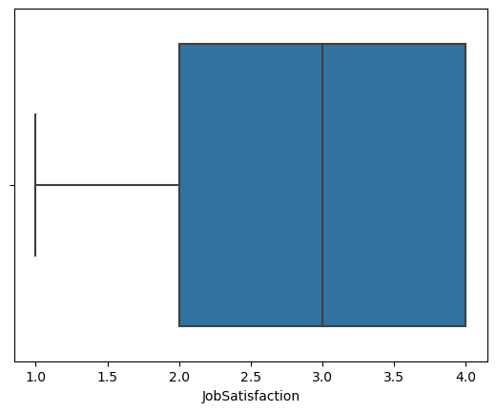
CONTINUOUS VARIABLES

Slide 10
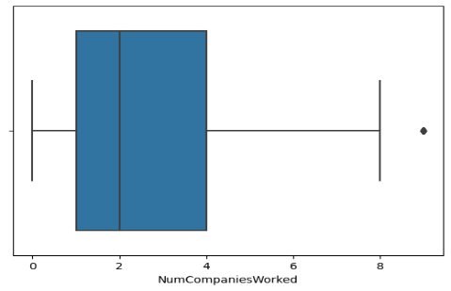
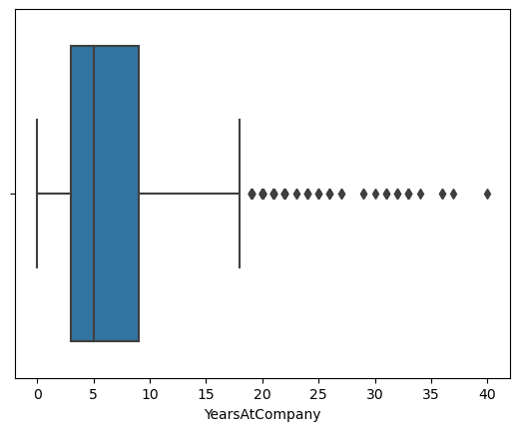

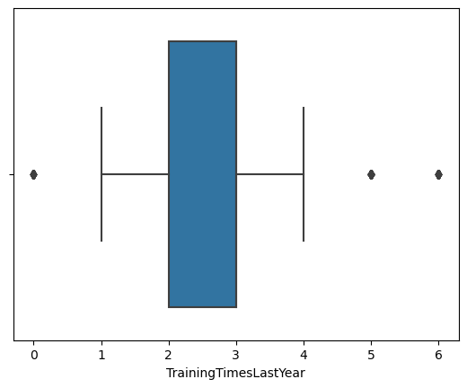

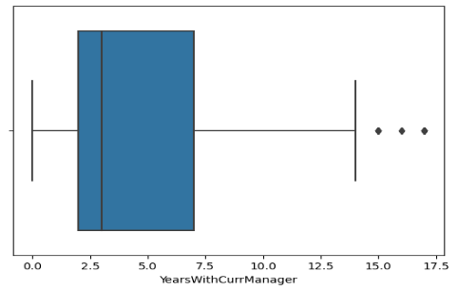
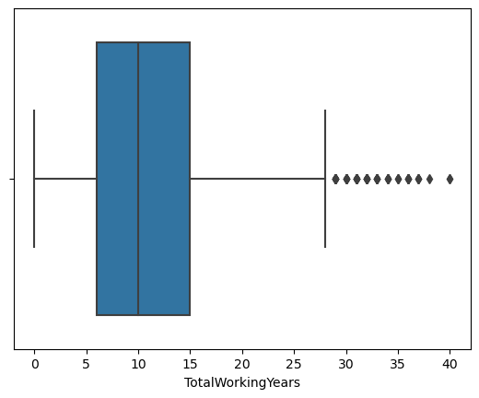
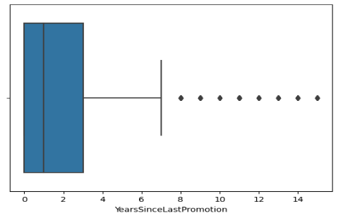
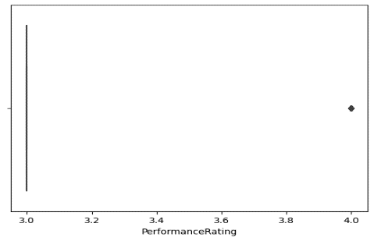
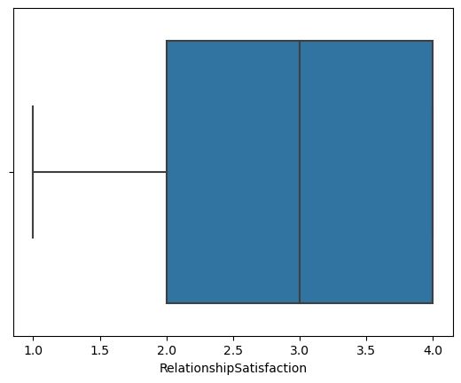
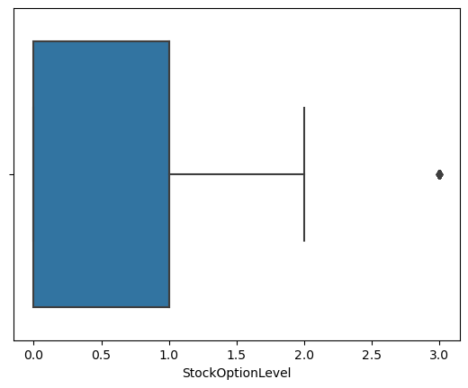
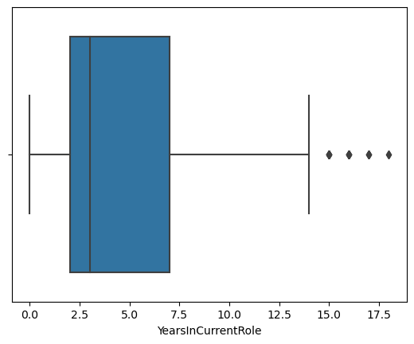

Slide 11
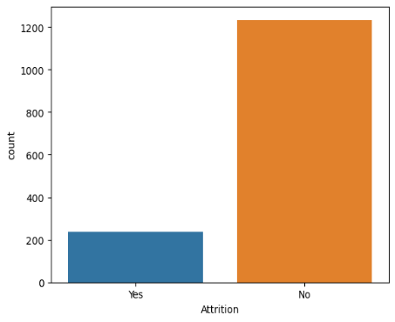
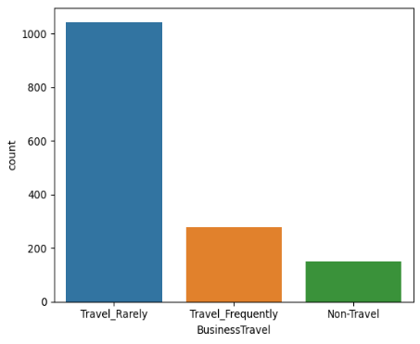
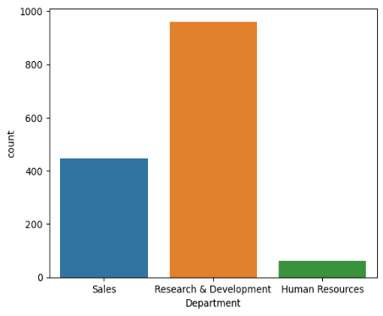
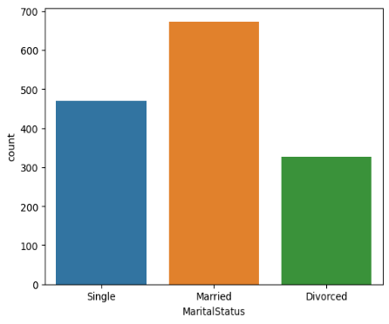
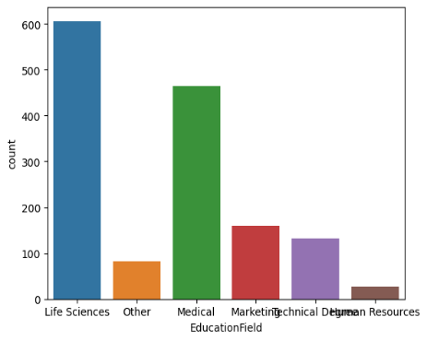
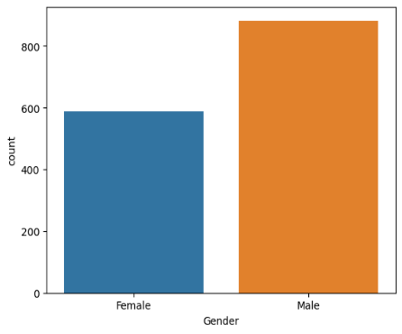
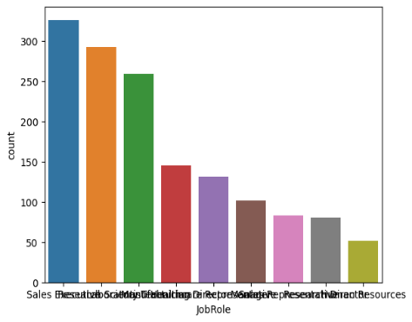
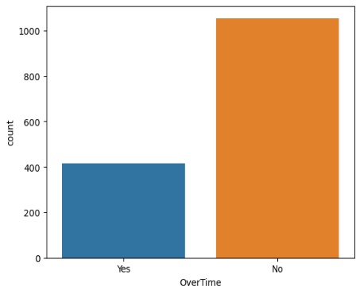
CATEGORICAL VALUES

Slide 12
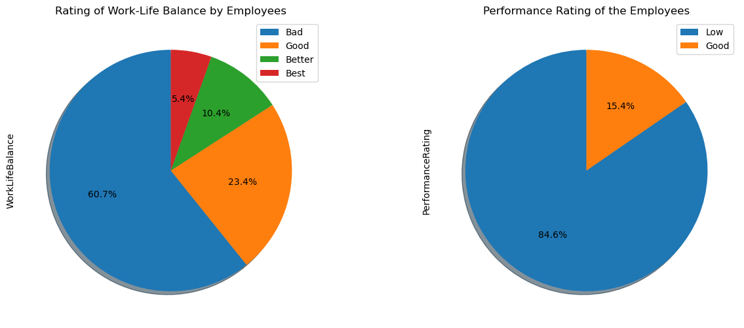
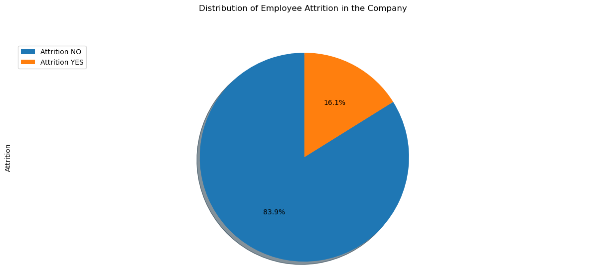
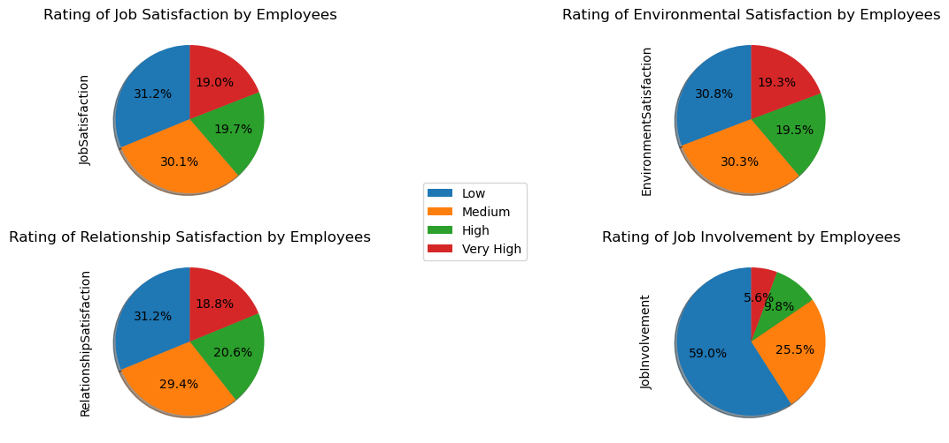
PIE PLOT

Slide 13
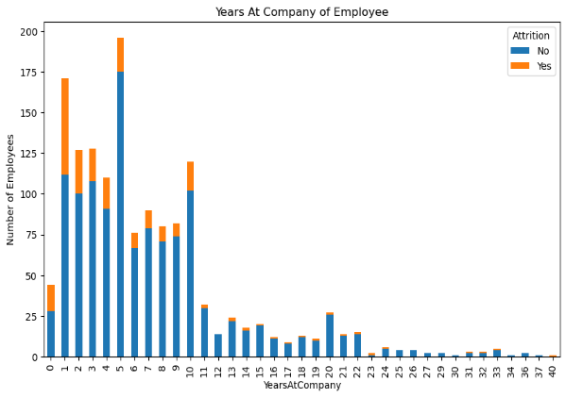
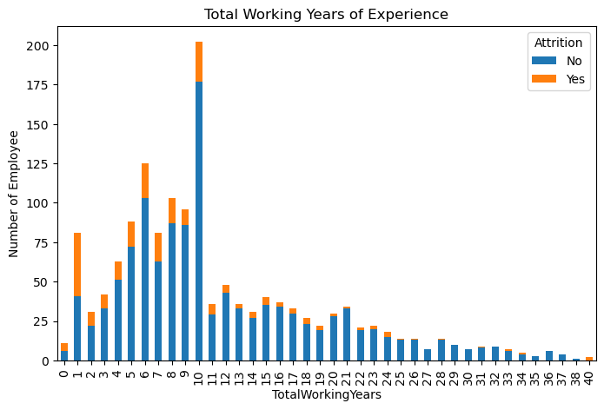
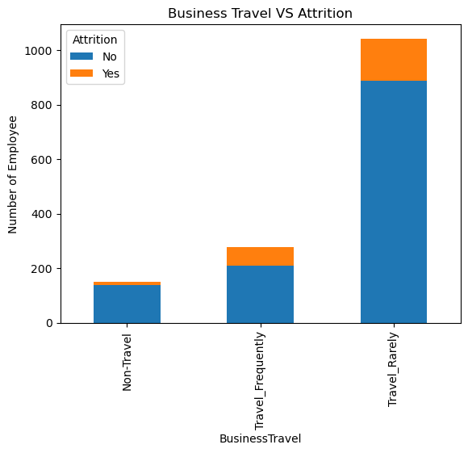


BAR PLOT

Slide 14

HEAT MAP

Slide 15


FEATURE ENGINEERING
LABEL ENCODING :-

Slide 16

FEATURE SCALING :-

Slide 17


Slide 18


LOGISTIC REGRESSION
Library used : sklearn.linear_model (LogisticRegression)
Split used for training and testing the data : 70-30
Feature Scaling was performed after splitting the dataset to avoid information leakage on testing dataset by using Standardization method.
Accuracy : 86.84 %
Recall : 0.88833747
Precision : 0.96495957

Slide 19


SUPPORT VECTOR MACHINE
Library used : sklearn.linear_model (svc)
Split used for training and testing the data : 70-30
Feature Scaling was performed after splitting the dataset to avoid information leakage on testing dataset by using Standardization method.
Accuracy : 86.39 %
Recall : 0.87112172
Precision : 0.98382749

Slide 20


NAÏVE BAYES
Library used : sklearn.linear_model (GaussianNB)
Split used for training and testing the data : 70-30
Feature Scaling was performed after splitting the dataset to avoid information leakage on testing dataset by using Standardization method.
Accuracy : 73.46 %
Recall : 0.9044586
Precision : 0.76549865

Slide 21


K-NEAREST NEIGHBOUR
Library used : sklearn.linear_model (KNeighborsClassifier)
Split used for training and testing the data : 70-30
Feature Scaling was performed after splitting the dataset to avoid information leakage on testing dataset by using Standardization method.
Accuracy : 85.94 %
Recall : 0.86873508
Precision : 0.98113208

Slide 22


DECISION TREE
Library used : sklearn.linear_model (DecisionTreeClassifier)
Split used for training and testing the data : 70-30
Feature Scaling was performed after splitting the dataset to avoid information leakage on testing dataset by using Standardization method.
Accuracy : 78.23 %
Recall : 0.88300836
Precision : 0.85444744

Slide 23


RANDOM FOREST
Library used : sklearn.linear_model (RandomForestClassifier)
Split used for training and testing the data : 70-30
Feature Scaling was performed after splitting the dataset to avoid information leakage on testing dataset by using Standardization method.
Accuracy : 85.03 %
Recall : 0.85882353
Precision : 0.98382749

Slide 24

Type I and Type II Error
“NAIVE BAYES”, has higher False Positives (FP) Value It Comes under Type 1 Error & , “RANDOM FOREST”, has higher False Negative (FN) Value. It Comes under Type 2 Error. So both of these are not well suited as compared to others.
Looking at these metrics, it appears that the Random Forest (RF) algorithm generally performs well across multiple measures. because its ability to identify negative instances like True Negatives (TN) & False Negatives (FN). However, it has a lower AUC ROC curve value as compared to others.

Slide 25

ACCURACY COMPARISION
CONCLUSION :-
“LOGISTIC REGRESSION” model has the highest accuracy as compared to other algorithms like SUPPORT VECTOR MACHINE, NAIVE BAYES, K NEAREST NEIGHBOUR, DECISION TREE & RANDOM FOREST. This model is best suited to Predict Or Analyse Employee Attrition.

Slide 26
Thank you!!

